Slide 1


SRI SIDDHARTHA INSTITUTE OF TECHNOLOGY
(A Constituent College of Sri Siddhartha Academy of Higher Education)
MARALUR, TUMAKURU-572105
Department of Computer Science And Engineering
TECHNICAL SEMINAR
ON
“EDGE COMPUTING”
Submitted by:-
Shreyas T M -18CS088
Under the guidance of :-
MADHUMALA G
Assistant Professor, CSE Dept.
SSIT , Tumakuru.
Date :- 07/02/2022

Slide 2
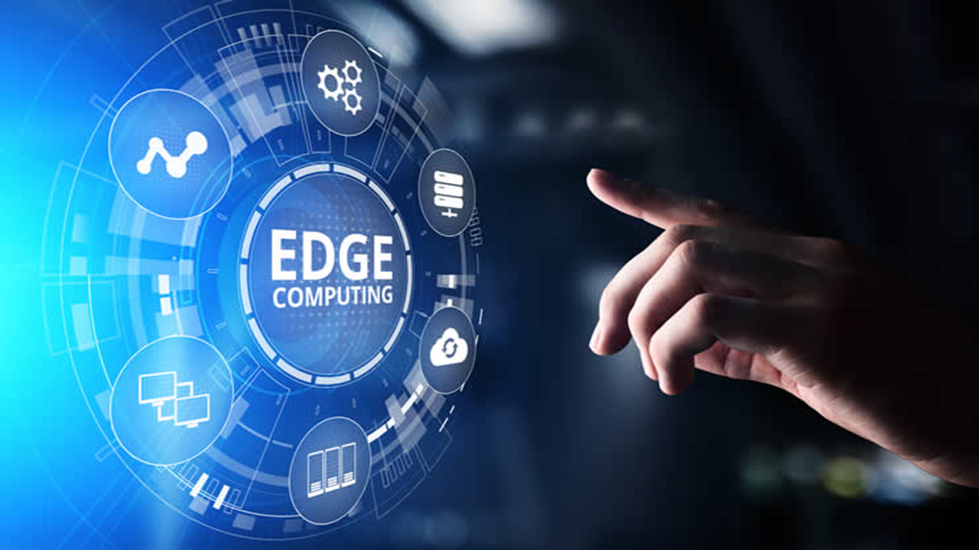
Overview of Edge Computing
Edge Computing is a distributed computing paradigm in which processing and computation are performed mainly on classified device nodes known as smart devices or edge devices, as opposed to processed in a centralized cloud environment or data centers.

Slide 3
Edge Computing Terms and Definitions
Edge
It highly depends on the use cases.
Like in telecommunication, it may be a cell phone or cell tower.
Similarly, in the automotive example, it could be a car.
In manufacturing, it could be a machine, and
In the Information Technology field, it could be a laptop.
Edge Devices
A device which produces data is edge devices like machines and sensors, or any devices through which information is collected and delivered.

Slide 4
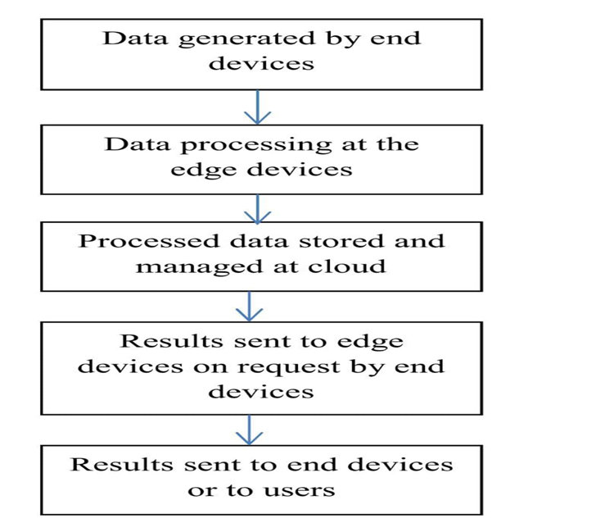
Data Flow diagram of Edge Computing

Slide 5
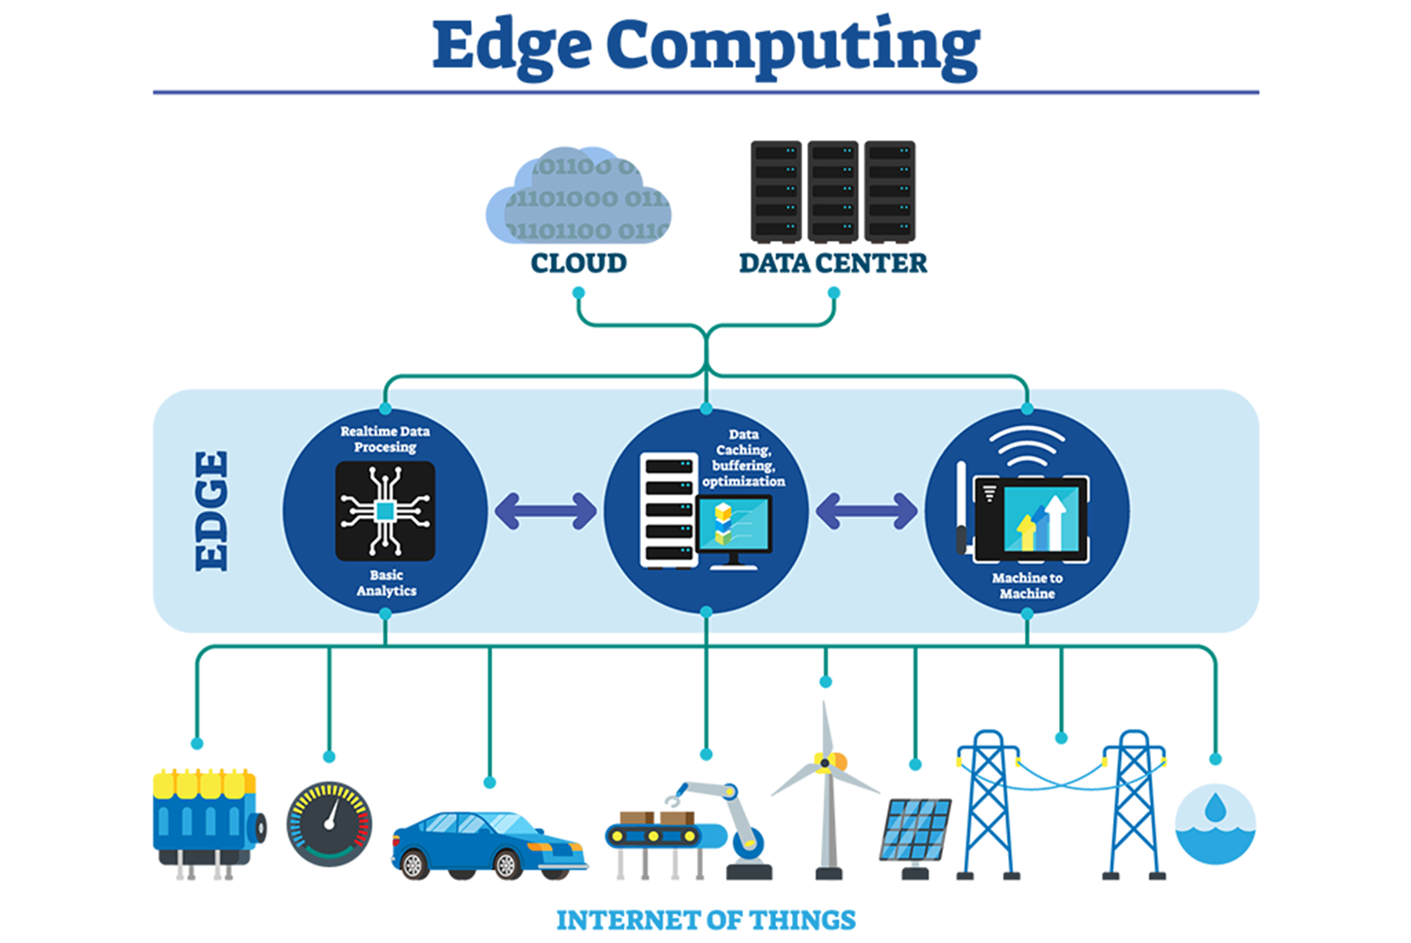

Slide 6
What exactly is Edge Computing according to research firms?
Gartner’s definition of edge computing: “Gartner defines edge computing as solutions that facilitate data processing at or near the source of data generation. For example, in the context of the Internet of Things (IoT), the sources of data generation are usually things with sensors or embedded devices. Edge computing serves as the decentralized extension of the campus networks, cellular networks, data center networks or the cloud”.
According to IBM,INTEL,SIEMENS:
A network of micro data centers that store or process critical data locally and push received data to a centralized data center or repository of cloud storage.
Typically in IoT use cases, a massive chunk of data goes through the data center, but edge computing processes the data locally results in reduced traffic in the central repository.
This is done by IoT devices, transferring the data to the local device, which includes storage, compute, and network connectivity.
After that, data is processed at the edge while another portion is sent to storage repository or central processing in the data center.

Slide 7
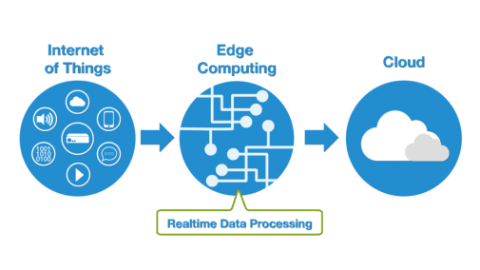
Internet of Things (IoT) and Edge Computing
In IoT, with the help of edge computing, intelligence moves to the edge.
There are various scenarios where speed and high-speed data are the main components for management, power issues, analytics, and real-time need, etc. helps to process data with edge computing in IoT.

Slide 8
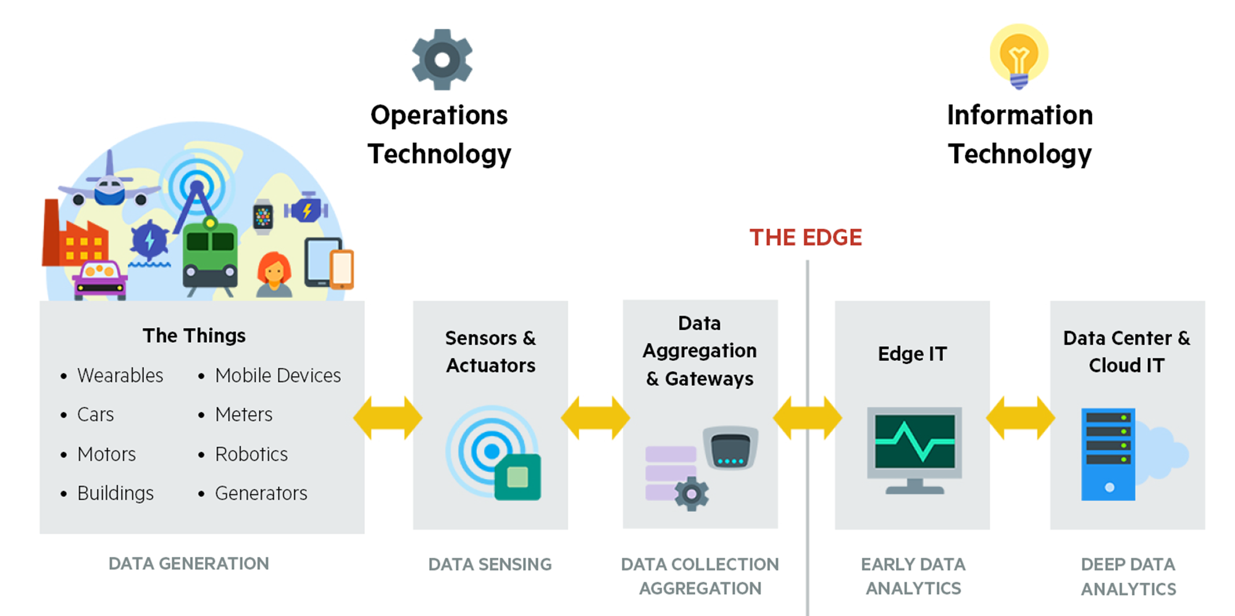

Slide 9
Benefits of Enabling Edge Computing for the Internet of Things (IoT)
Lesser Network Load
Zero Latency
Reduced Data Exposure
Costs and Autonomous Operation
Security and Privacy

Slide 10
Use of Edge Computing related to Industries
Smart applications and devices respond to data, instantly eliminating lag time.
Real-time data process with any latency where even milliseconds in latency make a difference in the processing of data.
Efficient data processing in massive data.
Effective use of the application in a remote location.
Security for sensitive data even without putting in the public cloud.

Slide 11
Role of Edge Computing in Healthcare
For example, in the hospital, we collect data from IoT devices, which is monitoring patients and transfer it to the trust’s electronic health record (EHR) from the bedside, with the authentication of staff to the IoT devices through proximity cards.
Role of Edge Computing in Social Good
Environmental factors like road traffic density, air quality, weather, school holidays, and other open data sets give better results by the processing of data with the help of edge computing and machine learning.

Slide 12
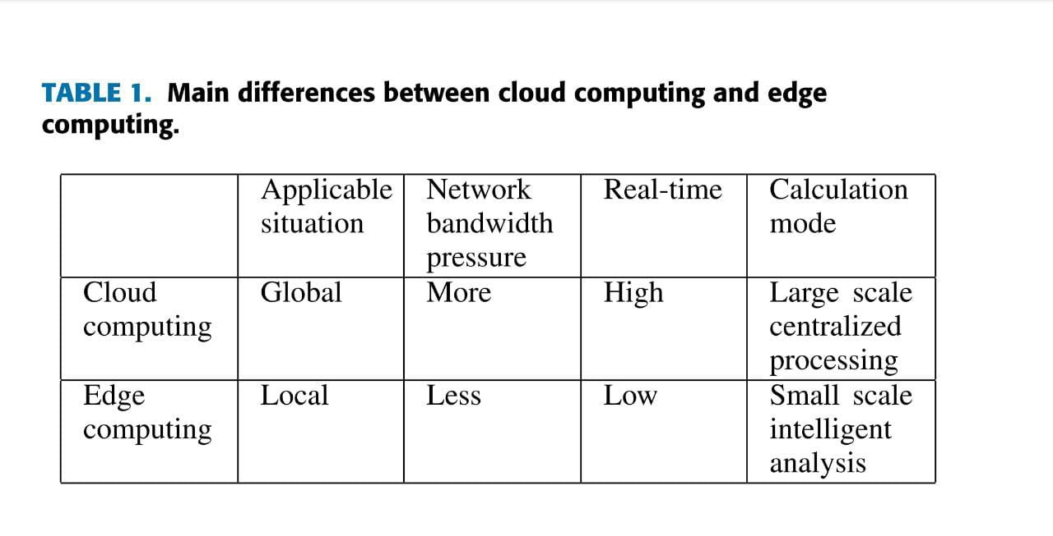

Slide 13
Future Directions of Computing for the Internet of Things (IoT)
Edge-to-Cloud data exchange capabilities
Use of 5G.
Use of AI and ML.
A growing list of vendors will provide edge computing products and services.
Future edge based applications.

Slide 14
CONCLUSION
As we are moving to a world with lots and lots of data and data processing, the need of a faster connection is becoming crucial.
While a centralized data center or cloud for data management, processing, storage has its limitations edge computing can provide an alternative solutions for this.
With edge computing things have become more efficient . As a result the quality of business operations has become higher.

Slide 15
BIBLIOGRAPHY
www.ibm.com
www.intel.com
www.jelvix.com
https://ieeexplore.iee.org
www.linkedin.com

Slide 16
Thank You

